Slide 1
New features in Polymer Genome
& Development Status
Chiho Kim
Materials Science & Engineering, Georgia Institute of Technology

Slide 2
OVERVIEW
Polymer Genome
Polymer fingerprint generator
Feature
engineering
tool
ML model
generator
Predictor
Utilities
Genetic algorithm toolkit
RFE
PCA
LASSO
One hot encoding
Linear regression
GPR
Input - SMILES
Learning curve
Output - Atomic / block / chain level fingerprints
Duplication checker
+ more tools

Slide 3
NEW FEATURES
Genetic algorithm toolkit
  Available on Gaanam2,3,4 and Tyrion2.
  Currently, applicable only for polymer design, but will be generalized.
Polymer fingerprinting API
  {.json} in, {.json} out
  Can be used in any languages (useful for end-users)
Updates on polymer fingerprinting
  ‘Short’ polymer issue fixed
  Added a new tag for ‘skipping’ side-chain related descriptors
Feature engineering tool
  Added LASSO for feature elimination

Slide 4
GENETIC ALGORITHM TOOLKIT
Genetic algorithm
Method for solving optimization problems based on natural selection, the process that drives biological evolution.
Parents
P₁
P₂
B₁₁
B₂₁
Genome breakdown position
B₁₂
B₂₂
Start
B₁₃
B₂₃
B₁₄
B₂₄
Generate Initial population
Crossover
Fitness function (evaluation)
B₁₁
B₁₁
B₂₁
B₂₁
Repeat
B₁₂
B₁₂
B₂₂
B₂₂
Selection
B₂₁
B₂₃
B₁₁
B₁₃
Parents
B₂₂
B₂₄
B₁₂
B₁₄
Mutation
Crossover
B₁₁
B₂₁
B₂₁
Mutation
B₁₂
Not mutated
B₂₂’
B₂₂
B₂₁’
B₁₁
B₁₃
Children
B₂₂
B₁₂
B₁₄’
Fitness function (evaluation)
Children
C₁
C₂
C₃
C₄

Slide 5
GENETIC ALGORITHM TOOLKIT
Application example
Goal – to design polymers with Tg>500 K & Eg>6 eV
Genome – polymer building blocks
ex) -CC-, -C6H4- …(~3,000 retrosynthetic fragments)
E_{g} = 8.2 eV / T_{g} = 558 K
E_{g} = 9.3 eV / T_{g} = 546 K
E_{g} = 9.1 eV / T_{g} = 552 K
HO
OH
*
*
N
OH
*
NH
*
F
F
O
NH
*
F
F
*
F
F
700
12
100th generation
10th generation
10
50th generation
1st generation
600
8
Glass transition temperature, predicted (K)
E_{g} = 6 eV
500
Bandgap, predicted (eV)
6
T_{g} = 500 K
Parent polymers
400
Maximum
Average
Minimum
4
Offspring polymers
PC₂
Average
1
10
100
1
10
100
PC₁
Generation
Generation

Slide 6
API-BASED POLYMER FINGERPRINTING
Benefit of API Application programming interface
Easy to bind to end-user’s codes
Language-agnostic
Not need to create fp_input
Not need to connect to G2, G3, G4, T2
API server
</CODE>
SMILES, API key
{.json}
Polymer fingerprint
Example code
1 2 3 4 5 6 7 8 9 10 11 12 | ﻿import requests import pprint url = 'http://api-server-address/' myJsonInput = { 'API-Client-Id':'******', 'API-PWD':'******', 'SMILES': 'CCC(CCCC)CCOCCCCOC'} result = requests.post(url, params=myJsonInput) pprint.pprint(result.json())
﻿In [1]: runfile('API-Caller.py') {'afpC4_C4_C4': 0.25, 'afpC4_C4_H1': 1.0454545454545454, 'afpC4_C4_O2': 0.09090909090909091, 'afpC4_O2_C4': 0.045454545454545456, 'afpH1_C4_H1': 0.3409090909090909, 'afpH1_C4_O2': 0.18181818181818182, 'bfp197': 0.8181818181818182, ... 'mfpNumAliphaticRings': 0.0, 'mfpNumAromaticRings': 0.0, 'mfptpsa': 0.10488636363636364}

Slide 7
UPDATES ON POLYMER FINGERPRINTING
What’s the issues?
  ‘Short’ polymer problem
  Side-chain related descriptors
fp([*]C[*]) ≠ fp([*]CC[*])
fp returns wrong result for short polymers (main chain length < 2)
like ([*]C[*]) → Fixed
# | key | definition
21 | side_chain_abs | Absolute length of the shortest side chain
22 | side_chain_large_abs | Absolute length of the longest side chain
fp takes too long computation time for complex polymers
To bypass use a tag compute_side_chain = 0

Slide 8
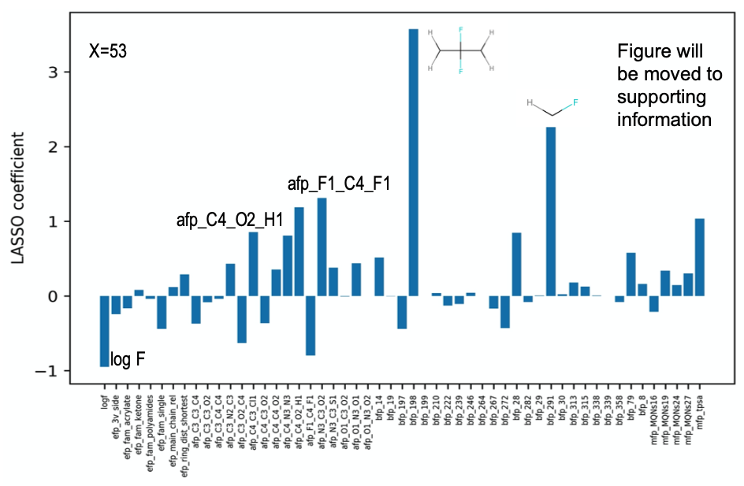
LASSO FOR FEATURE ELIMINATION
LASSO least absolute shrinkage and selection operator
A regression analysis method that performs both variable selection and regularization in order to enhance the prediction accuracy and interpretability of the statistical model it produces.
See the movie that shows how LASSO
simplifies regression model by eliminating silly descriptors → https://www.youtube.com/watch?v=NGf0voTMlcs
Input for fe to run LASSO
file_fp_prop = fp_prop.csv
col_X = aT bT m e
col_Y = DFT_bandgap
job = LASSO
LASSO_n_fold = 5
LASSO_col_X_keep = afp_C4_C4_C4 bT
LASSO_file_fp = fp_prop_LASSO.csv
verbosity = 1

Slide 9
DEVELOPMENT STATUS
Underway
  Ladder polymer – Polymer drawer, fingerprinting & dataset
  Block level polymer fingerprinting – completeness, uniqueness & minimal
  Documentation (GA)
Staggering
  Side-chain related fingerprinting algorithm – staggering
  Polymer Genome Webserver – mirroring site (backup for emergency)
  Data mining & curation & model development –
Intrinsic_viscosity_eta
Specific_volume
Crystallization_temp.
Surface_tension
Linear_expansion_coefficient
Gas_solubility_coefficient_(S)
Contact_angle
Volume_expansion_coefficient
Softening_temp.
LC_phase_transition_temp.
Water_absorption
Gas_diffusion_coefficient_(D)
Melt_viscosity

