Slide 1
Predicting simple linear polymers crystal structures
Huan Tran
School of Materials Science & Engineering, Georgia Institute of Technology

Slide 2
Computational data for polymers informatics
Overall plan: automate the polymer data generation in a targeted and guided manner
Data in polymer informatics: data generation, data management, data representation and learning
Data generation: From SMILES (we have a lot thanks to Chiho and Rohit), how to determine crystal structures (an acceptable level of polymer models) for further DFT calculations?
Data management: organize, store, quality control
Data representation and learning: fingerprinting/featuring, feature engineering, learning and inverse design

Slide 3
Hierarchy of polymers models
A nice figure
[*]CC([*])CC
Even more?
SMILES
Molecule
Chain
Crystal
Amorphous

Slide 4
Polymer crystal structure predictions
A nice figure
[*]CC([*])CC
Even more?
SMILES
Molecule
Chain
Crystal
Amorphous

Slide 5
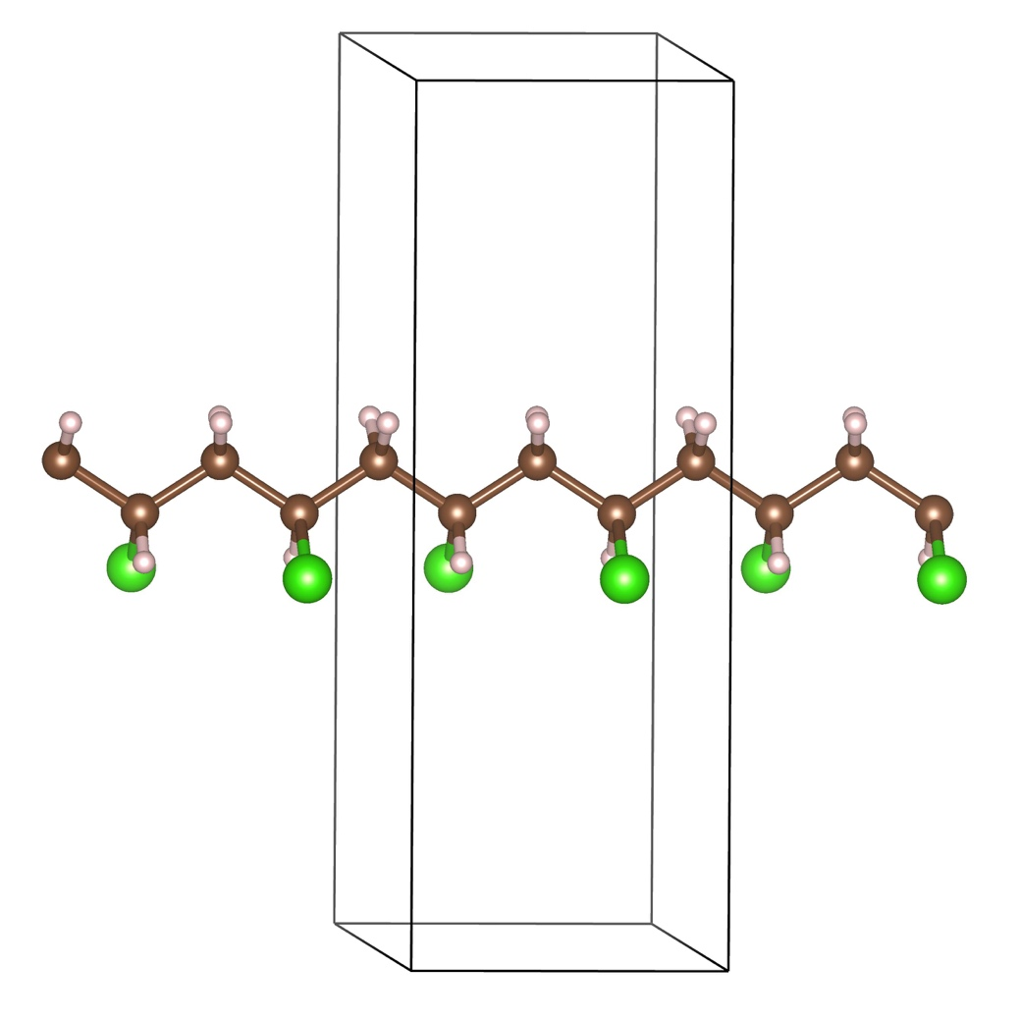
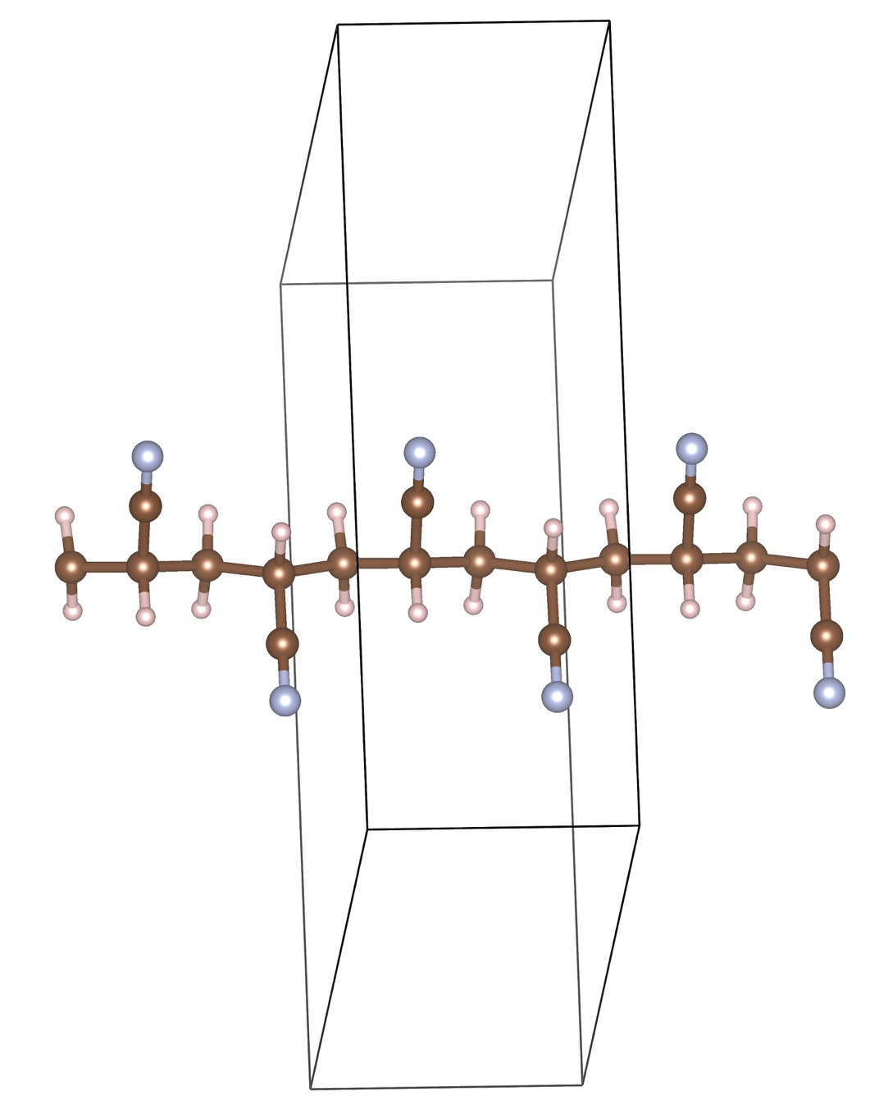
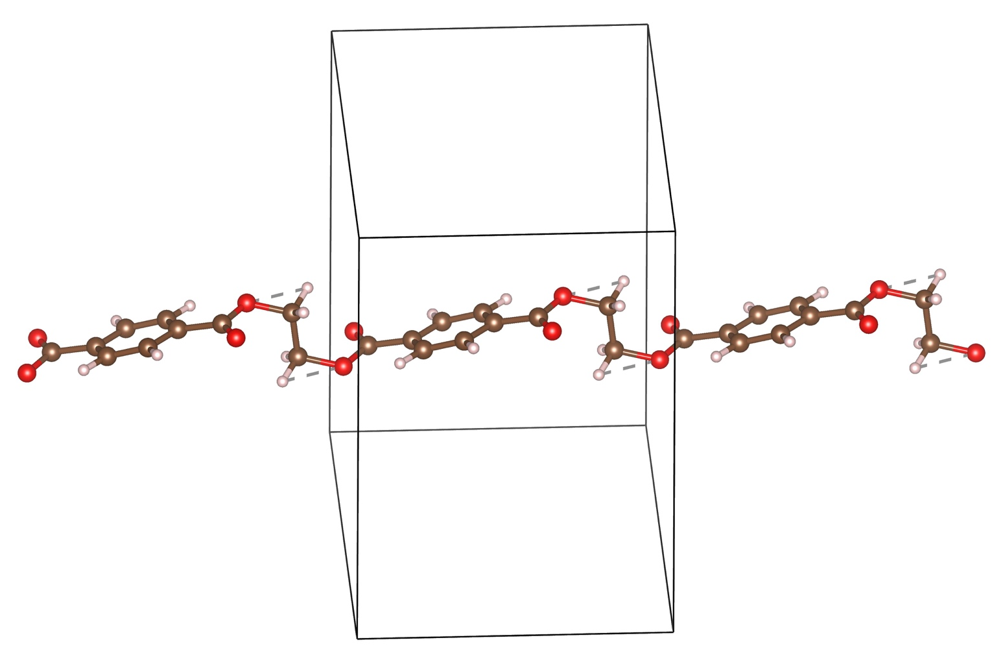
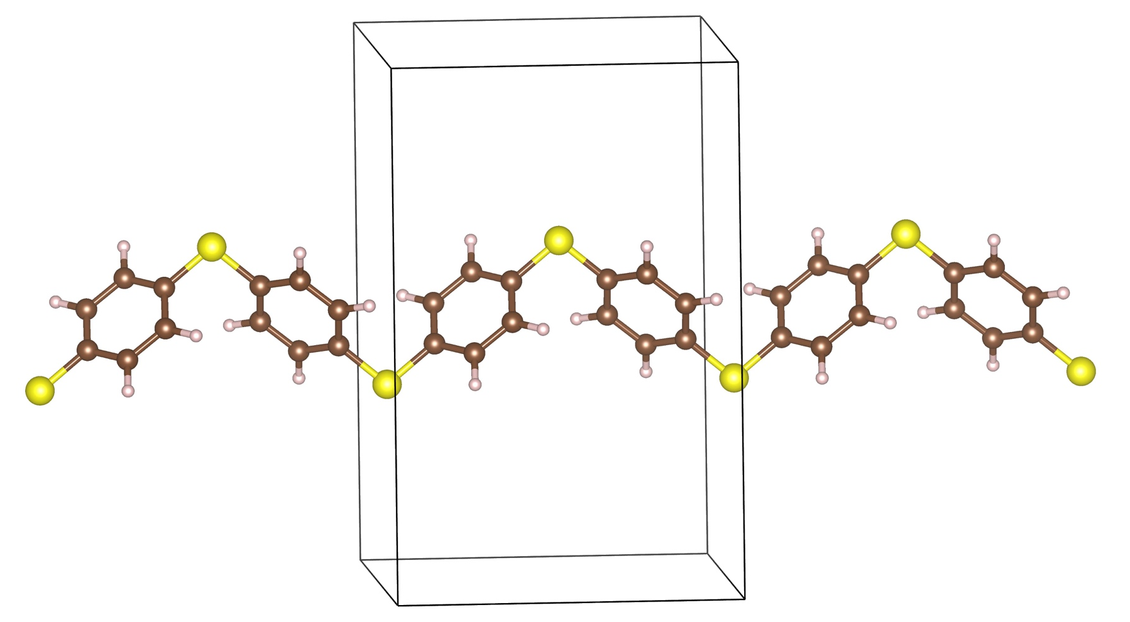
Polymer chains
Polyethylene terephthalate
PET
Poly (vinyl chloride)
PVC
Polyacrylonitrile
PAN
About 1,600, mostly generated computationally from SMILES
Poly(p-phenylene sulfide)
PPS

Slide 6
Polymer chain → crystals
Having a chain, how to get a stable 3D crystal structure (lowest in energy)?
Generic crystals structure prediction methods: atoms are treated independently, i.e., find lowest-energy arrangement of the independent atoms
- Very inefficient for polymers: atomic connectivity disregarded, too many unnecessary degrees of freedom
Our approach: polymer chains are treated independently, i.e., find lowest-energy packing of them
- Chain geometry assumed to be correct
- 2 chains are packed in different ways, covering the possible degrees of freedom
- Optimize the generated inputs, determine the lowest energy structures

Slide 7
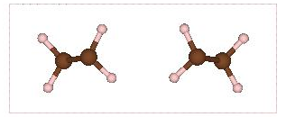
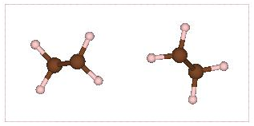
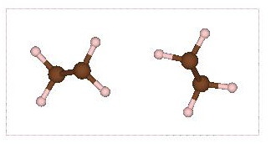
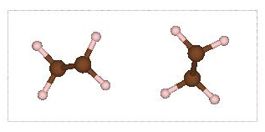
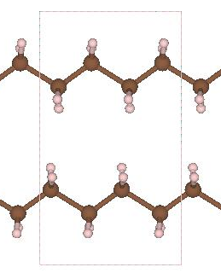
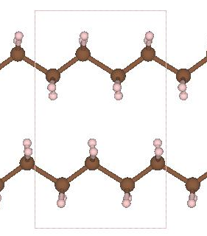
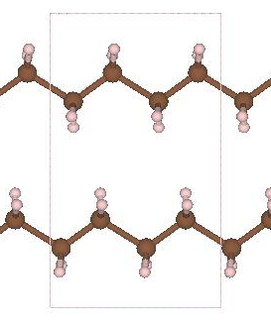
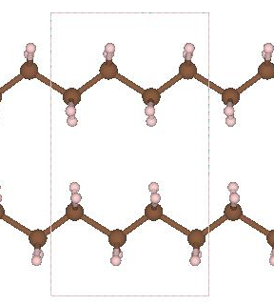
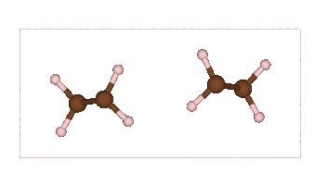
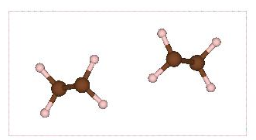
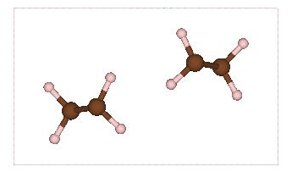

Polymer chain → crystals
3 degrees of freedom, 5 values of each, resulting in ~100 input configurations
To be efficient, any interchain distance (including images) no larger than a threshold (2.2 A)

Slide 8
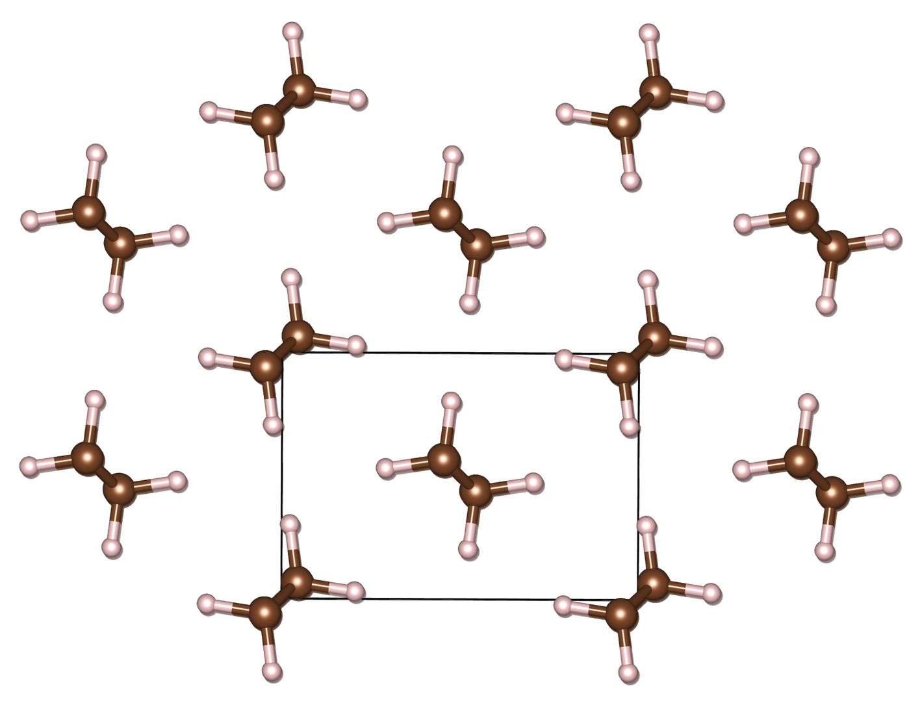
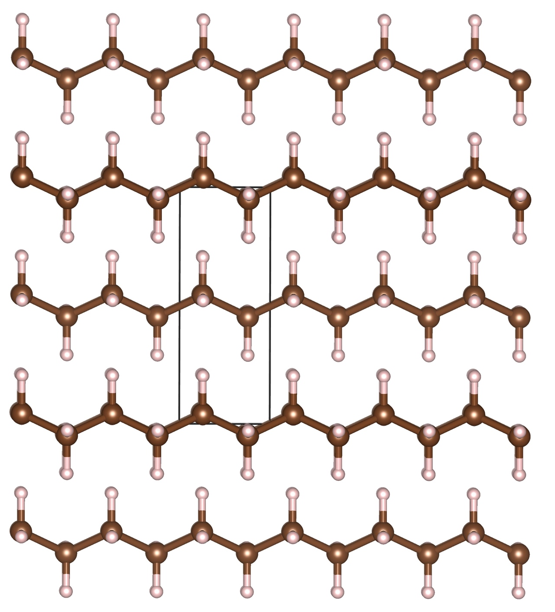
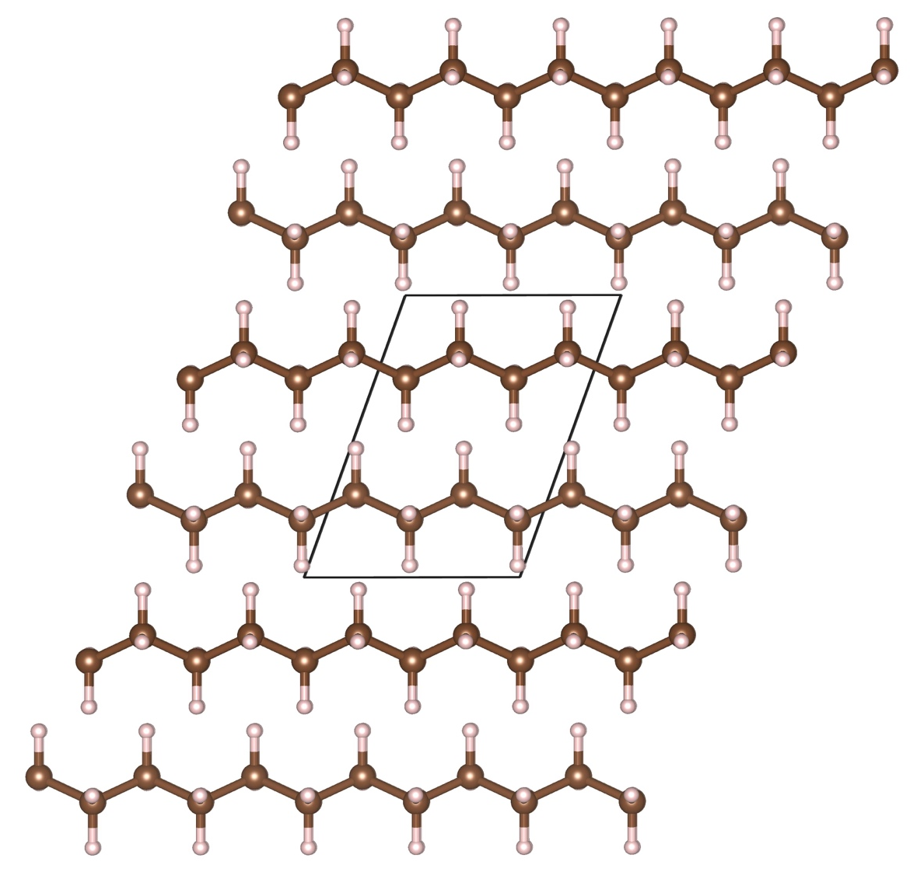
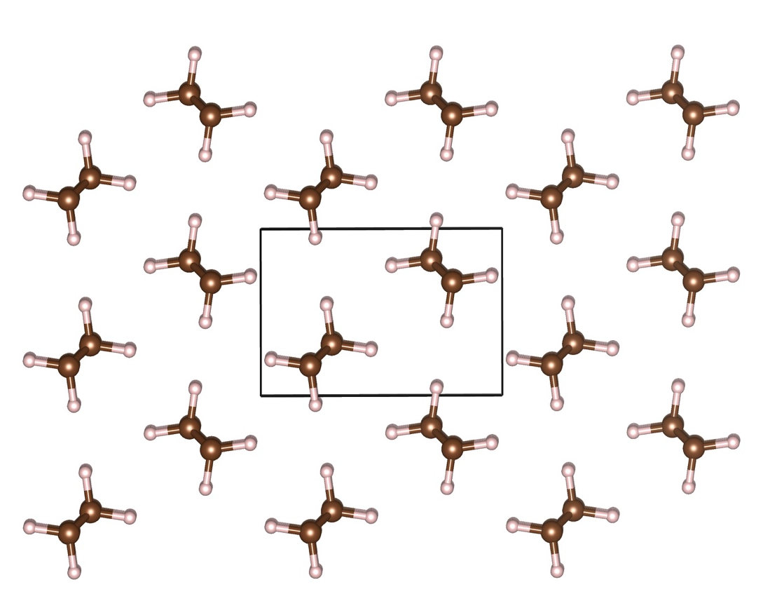
Result: PE
Expr.
Pred.

Slide 9
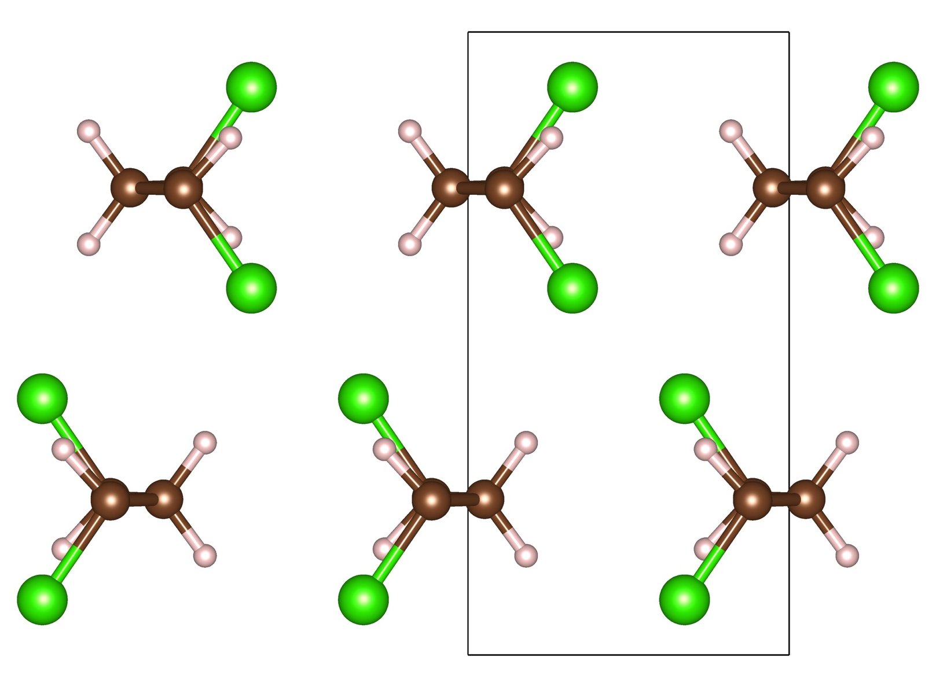
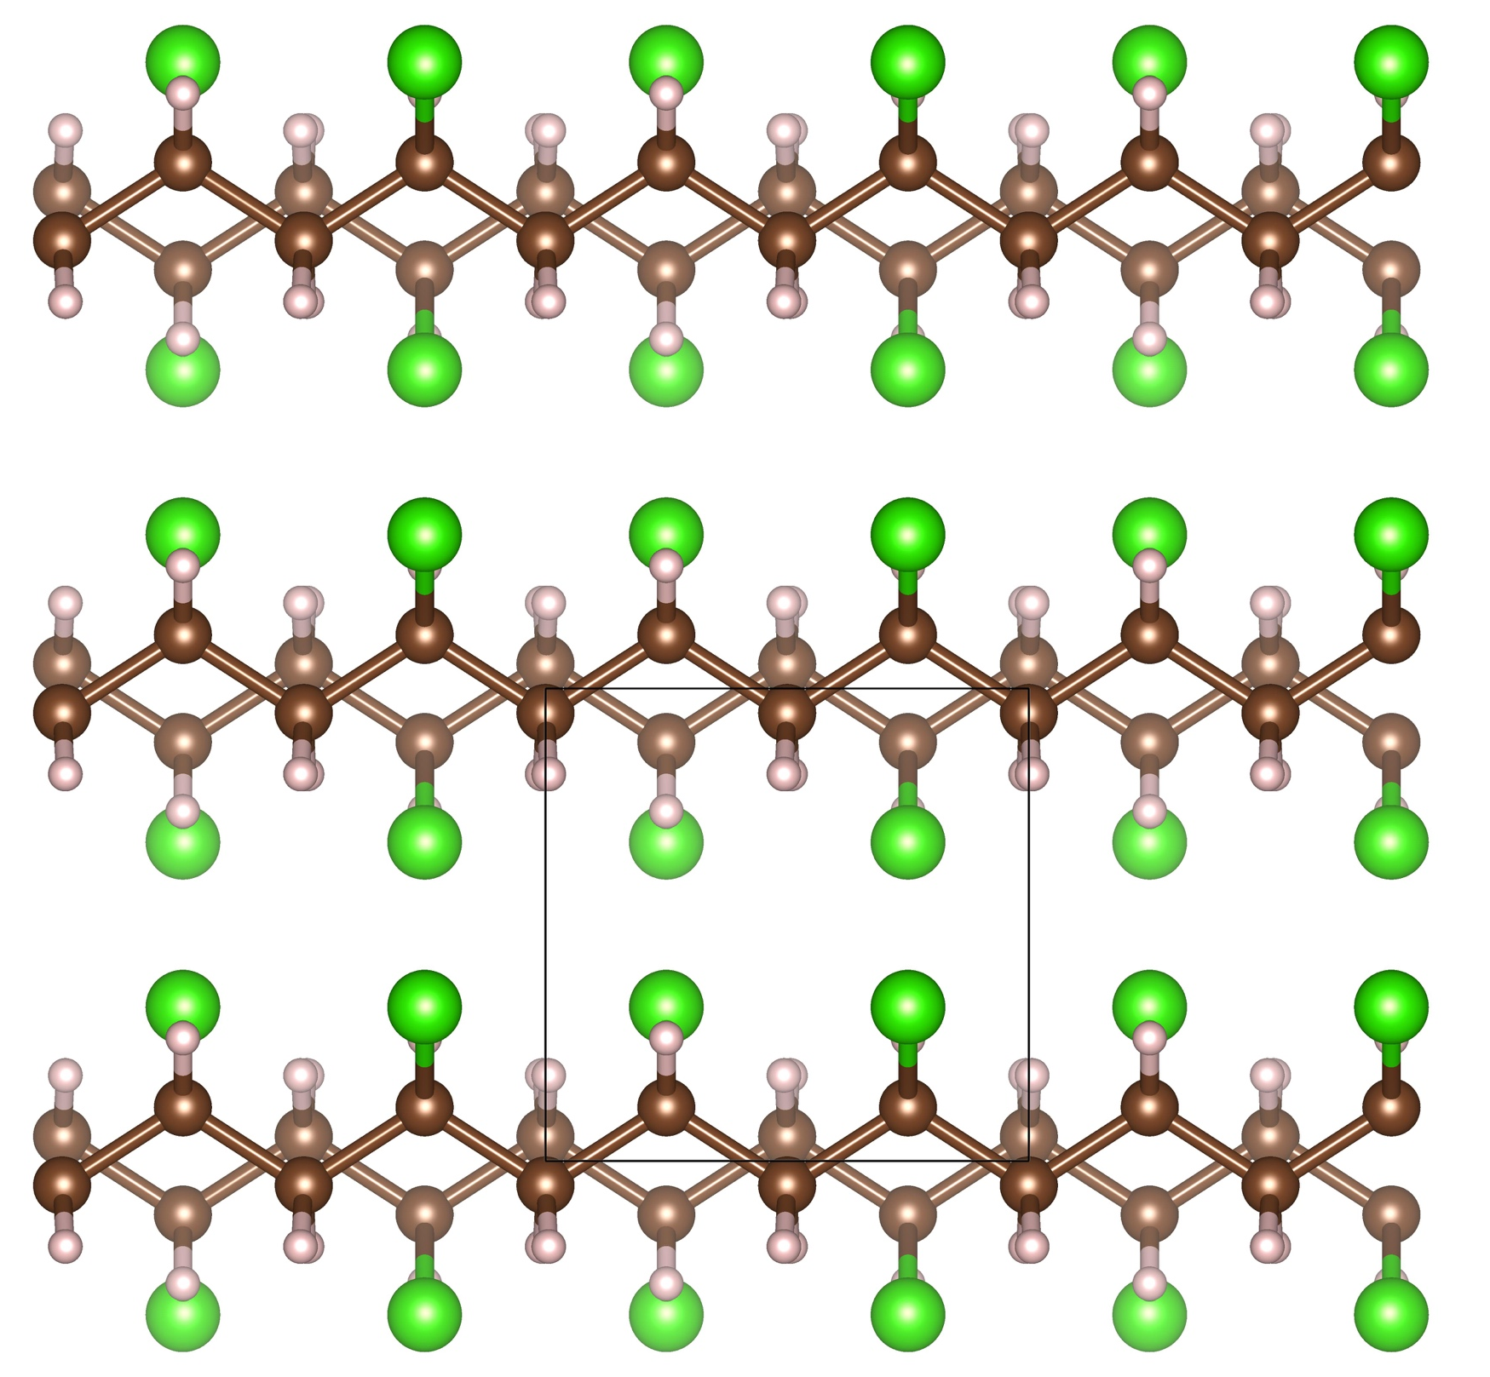
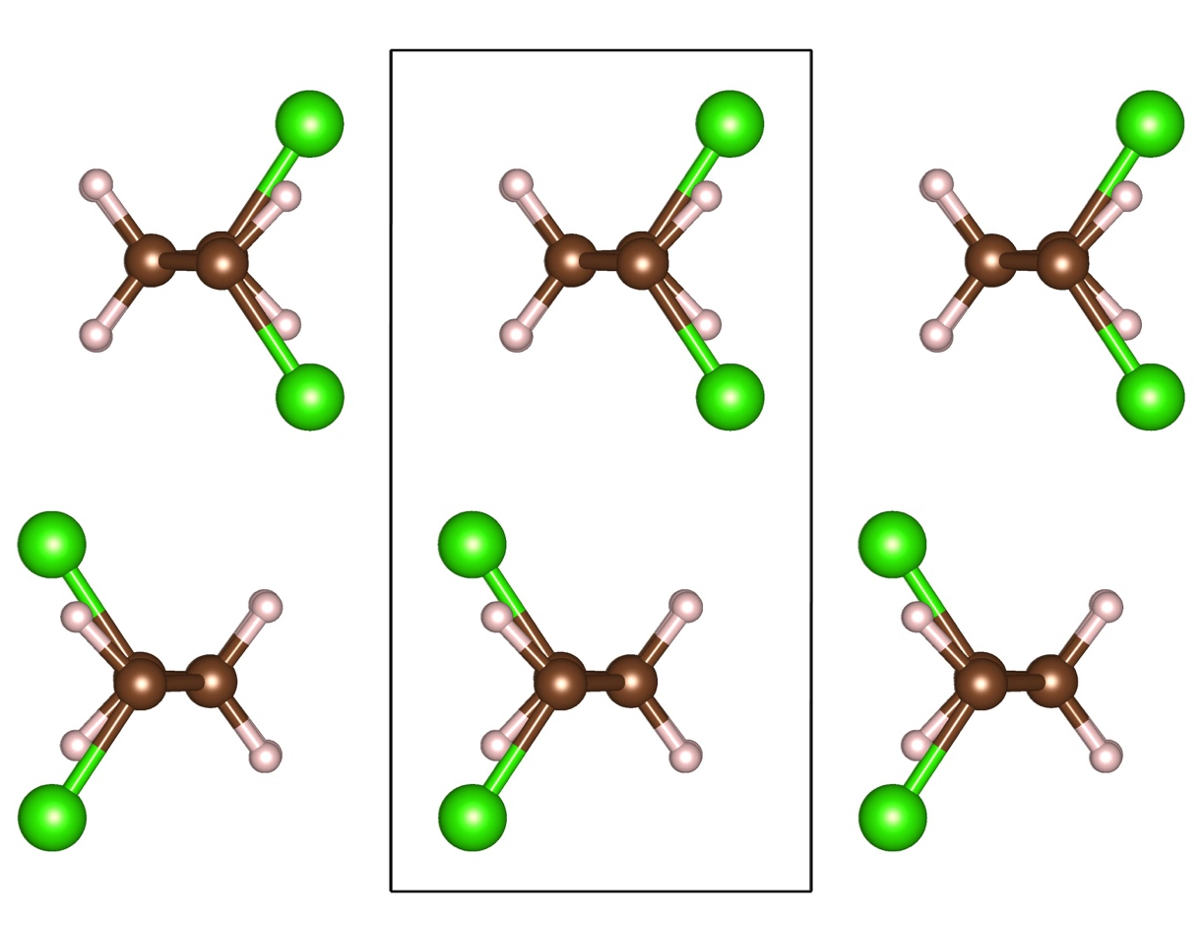
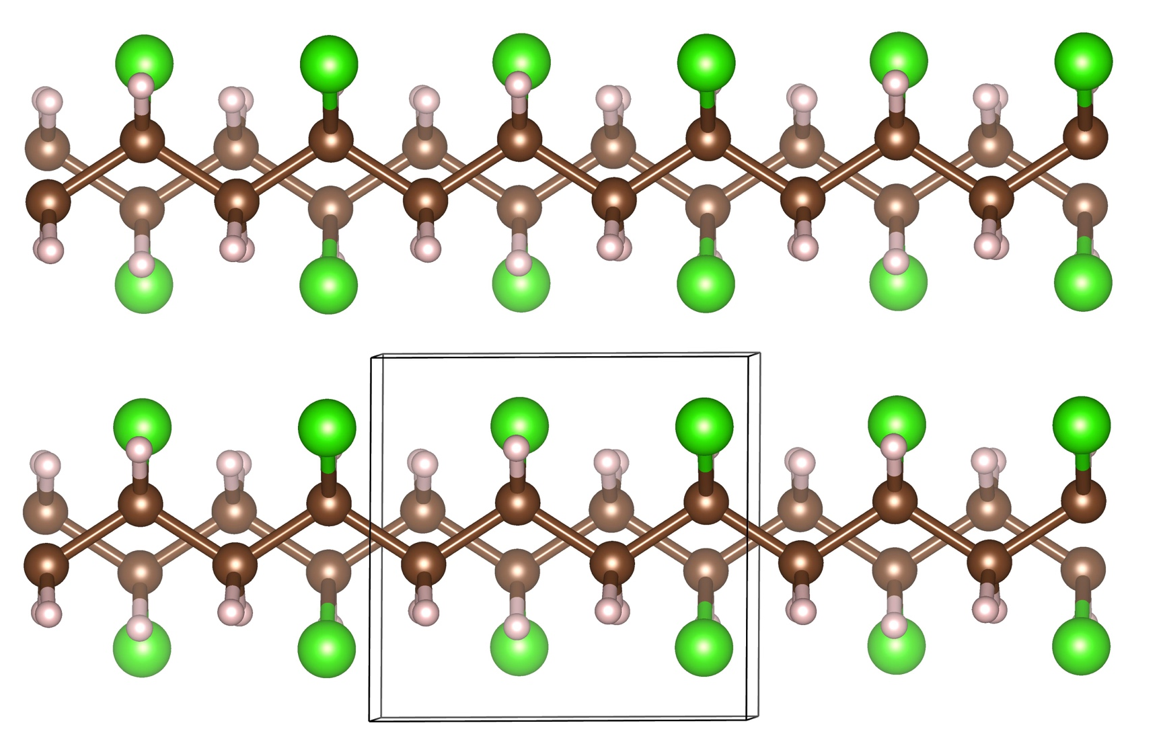
Result: PVC
Wilkes et al., Macromolecules 6, 235 (1973).
5.01 A
Expr.
2.81 A
4.94 A
Pred.
2.77 A

Slide 10
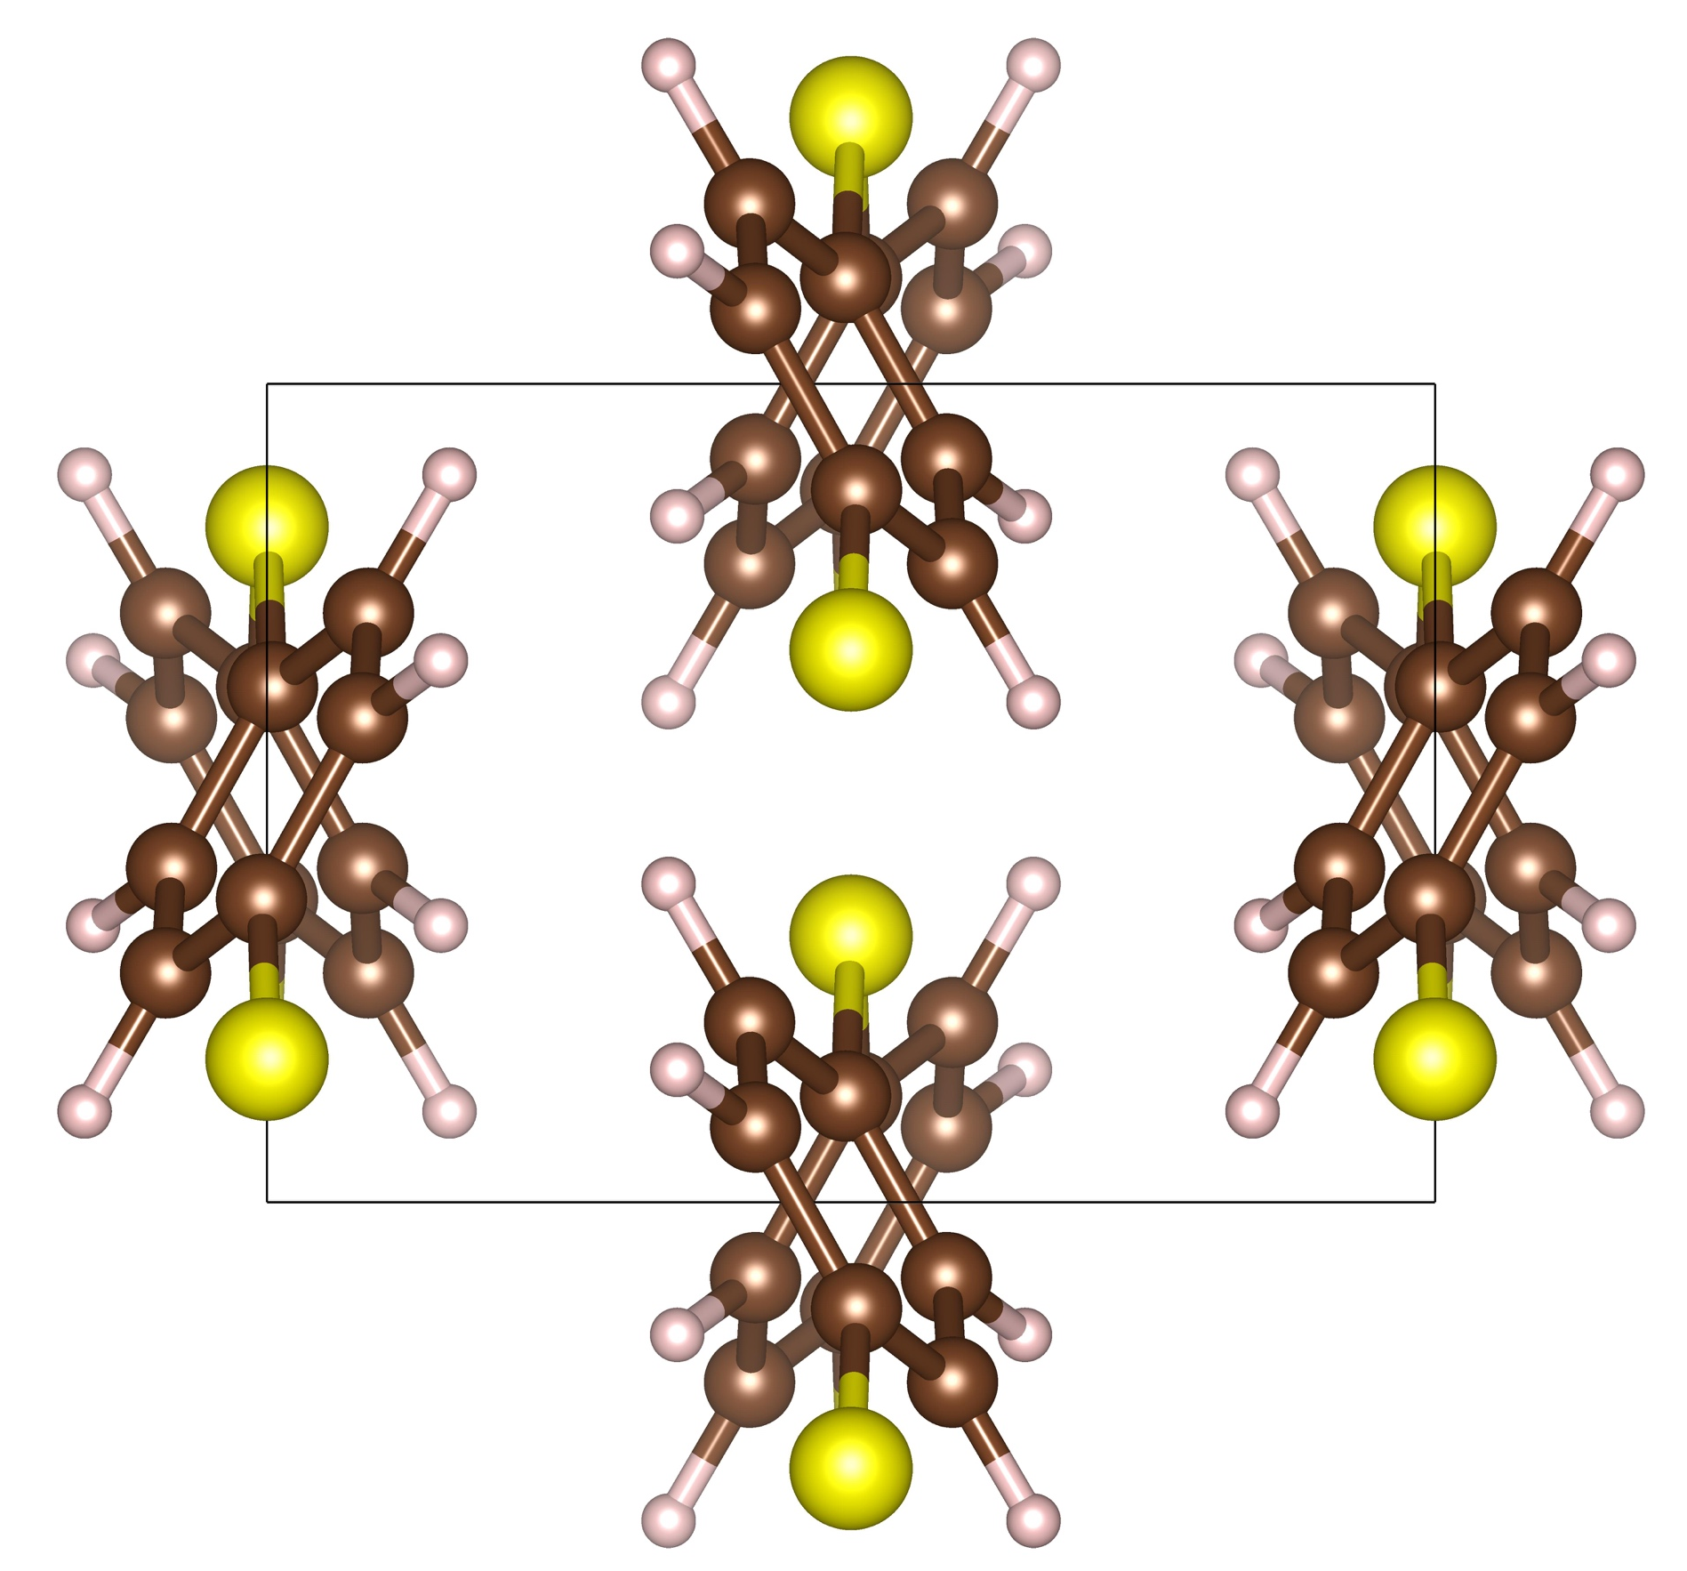
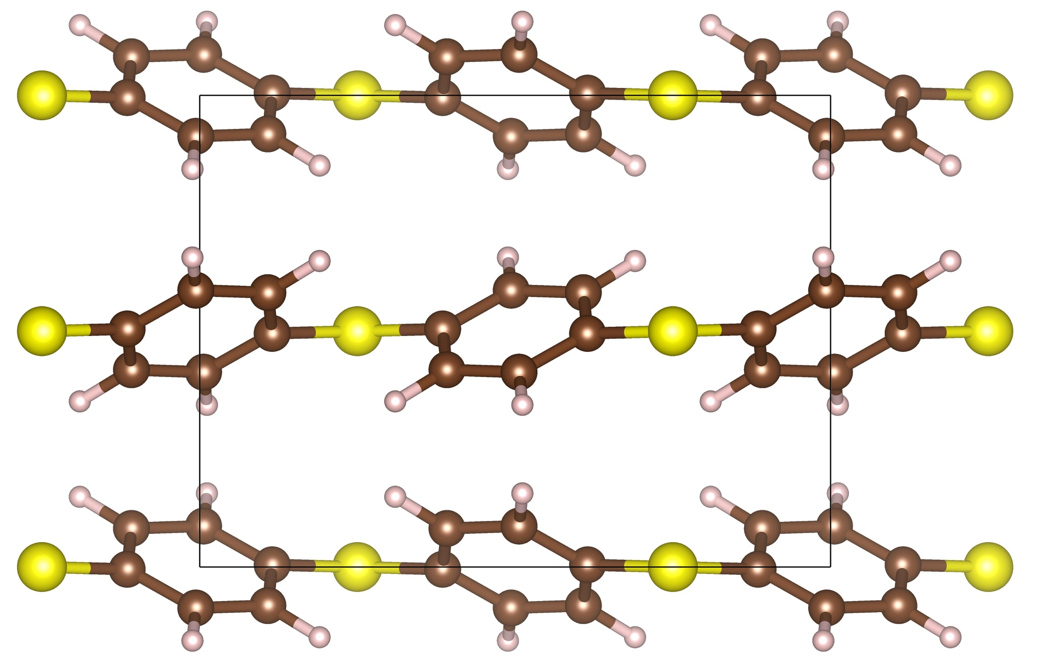
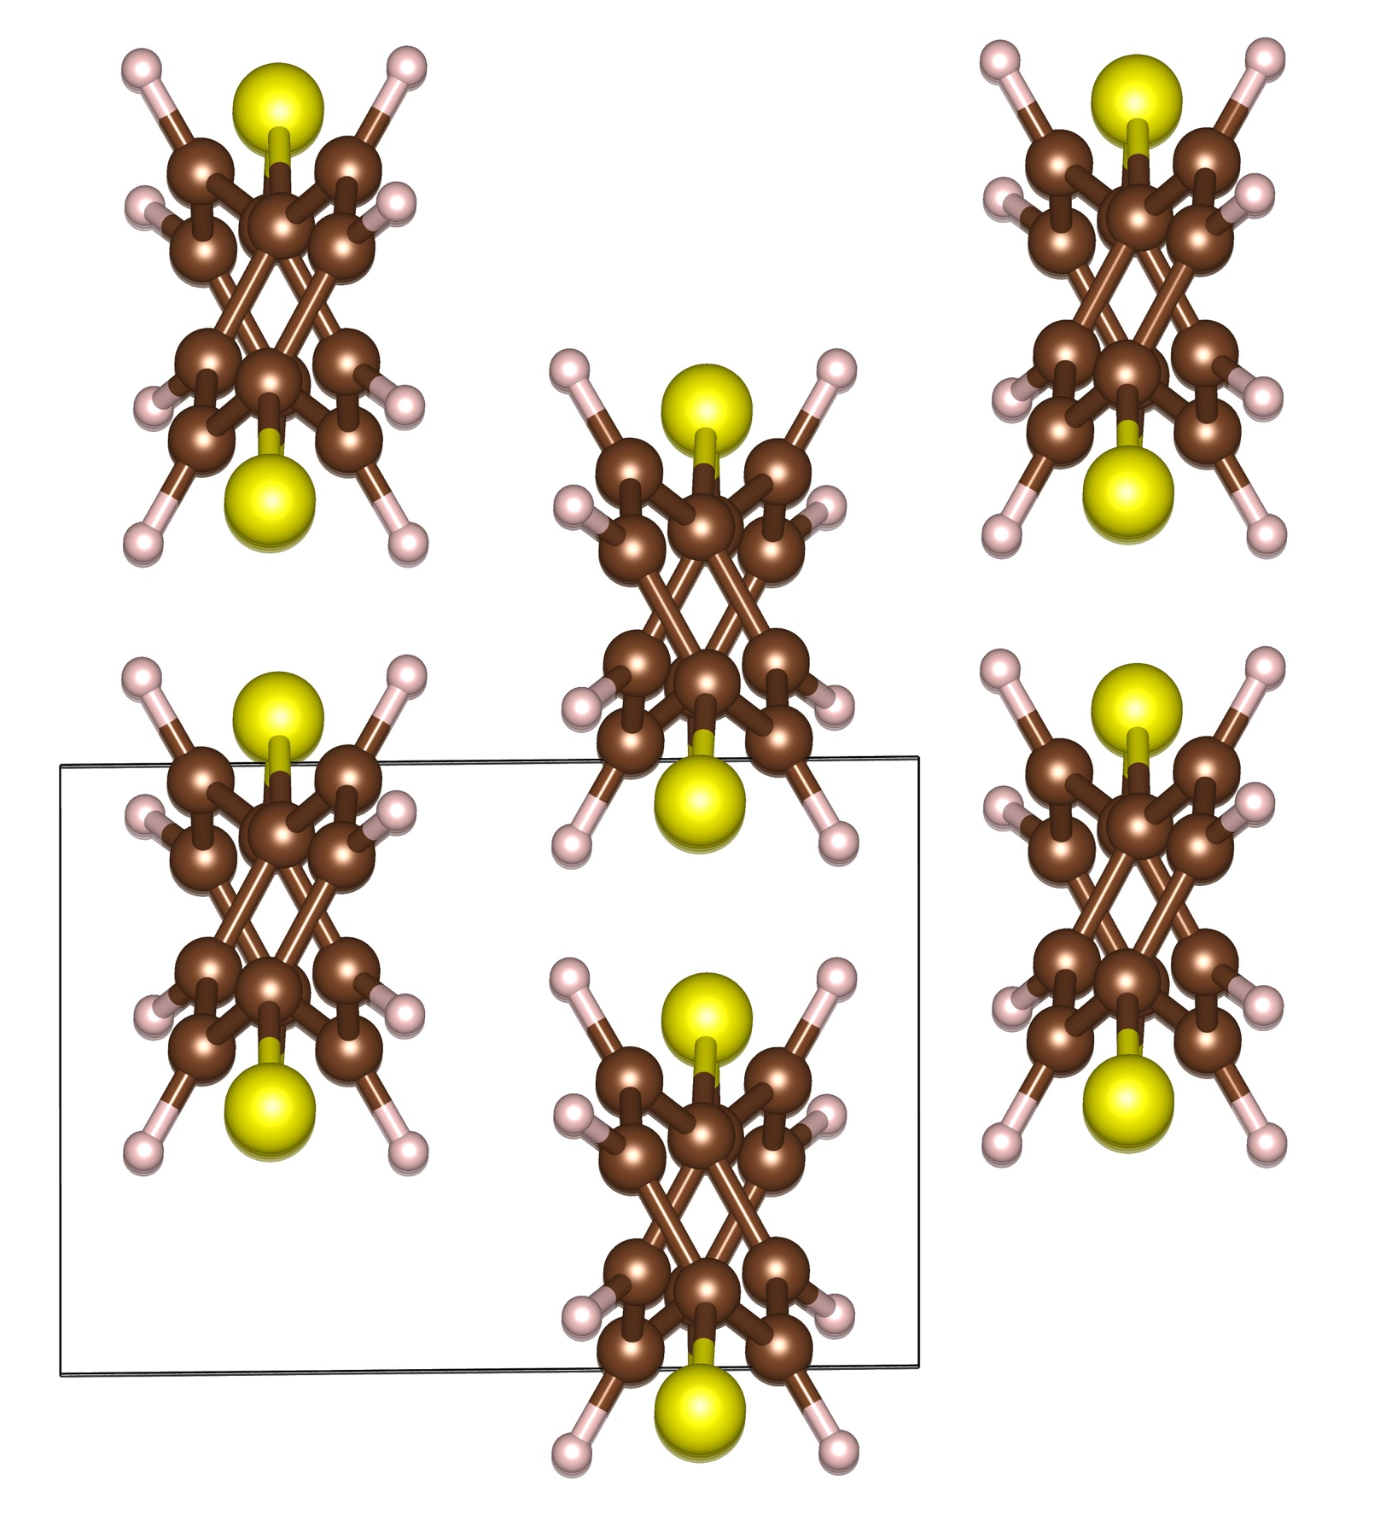
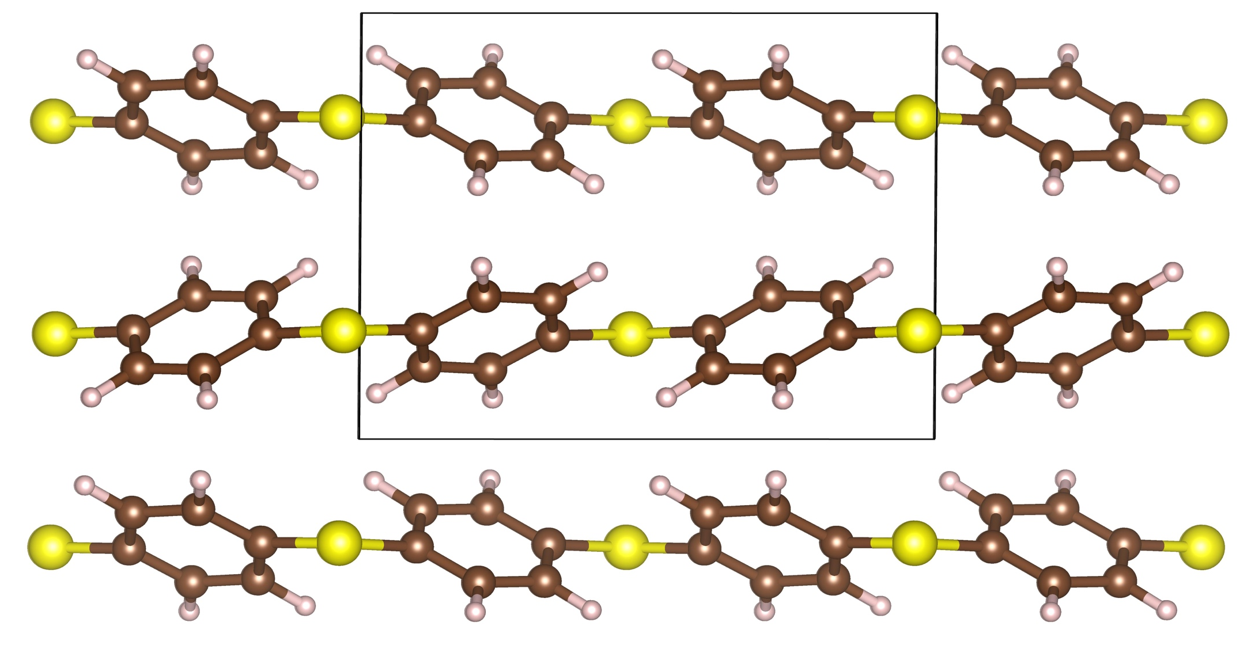
Result: PPS
Tabor et al., Eur. Polym. J. 7, 1127 (1971).
Expr.
4.81 A
Pred.
4.78 A

Slide 11
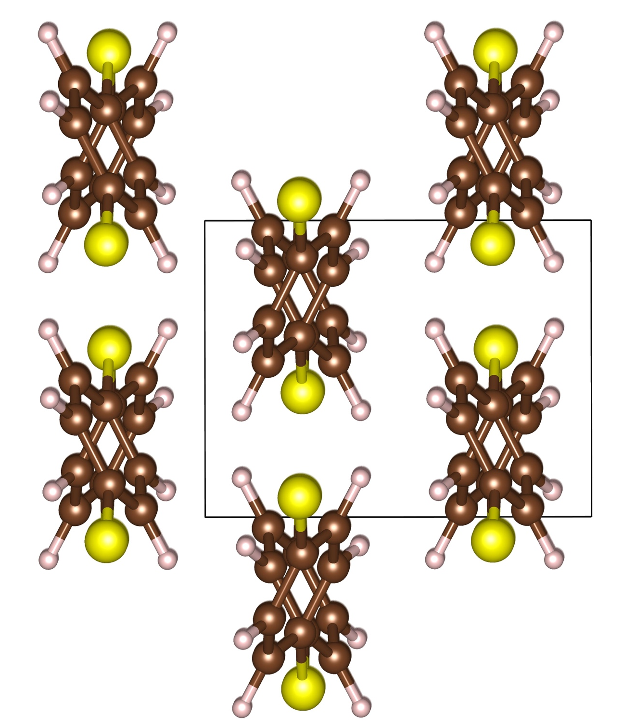
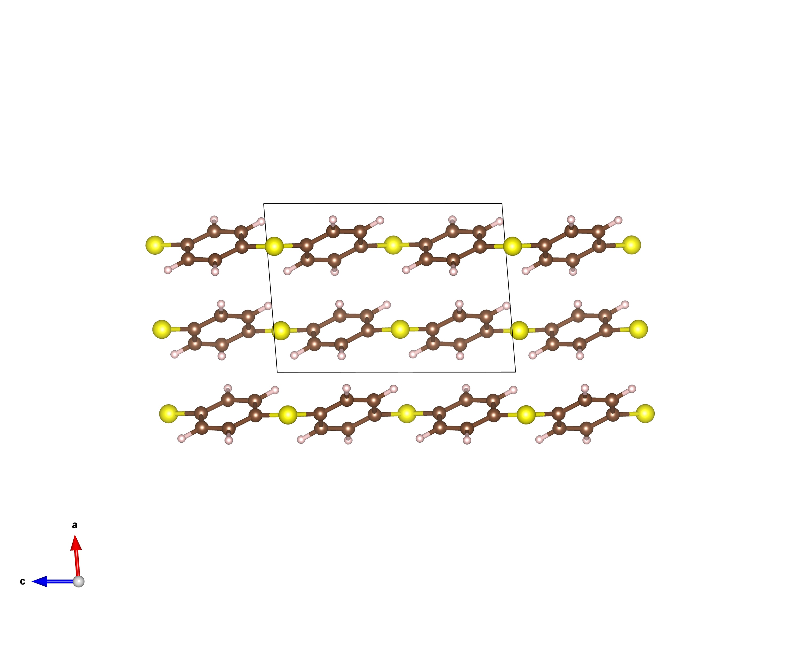
Result: PPS
Tabor et al., Eur. Polym. J. 7, 1127 (1971).
Expr.
4.81 A
Pred.
New structure, 0.1 eV/atom lower
(too small, polymer interchain energy scale!)

Slide 12
Some thoughts
Very efficient compared to conventional structure prediction methods, straightforward to automate
Chain conformation must be correct
- Current SMILES to chain conversion unverified to be correct. Attempts by Harikrishna ongoing
- 2 chains per cell assumed, more can be added
Better ways (fingerprint) needed to distinguish polymer structures, further developing PG models
Pieces of tools available, need to be integrated and organized, work started
Going forward in the hierarchy of models: amorphous and more?

